Slide 1
eCommerce Data Analysis & Machine Learning
Clustering, Regression, and Classification

Slide 2
Project Overview
Objective:
Perform data analysis and build predictive models for an eCommerce dataset.
Analyze customer behavior and predict their activity level and spending patterns.
Key Tasks:
Exploratory Data Analysis (EDA)
Clustering (Customer Segmentation)
Regression (Predicting Total Spend)
Classification (Predicting Activity Level)
Model Evaluation

Slide 3
Dataset Overview
Dataset: eCommerce dataset containing customer transaction data.
Key Variables:
CustomerID: Unique identifier for each customer.
InvoiceDate: Date and time of transaction.
Quantity: Quantity of items purchased.
UnitPrice: Price per unit of the item.
Country: Country where the customer is located.
StockCode: Product code for items purchased.

Slide 4
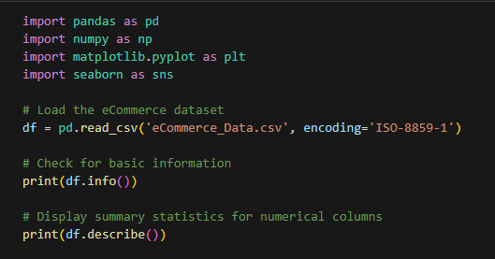
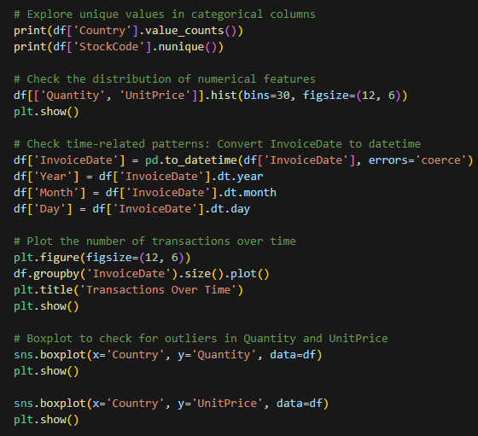




Slide 5
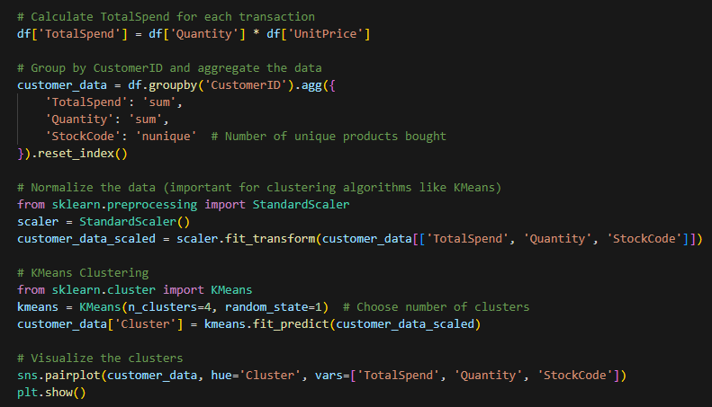
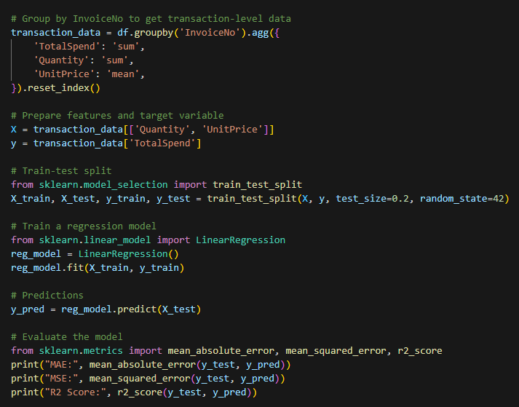



Slide 6
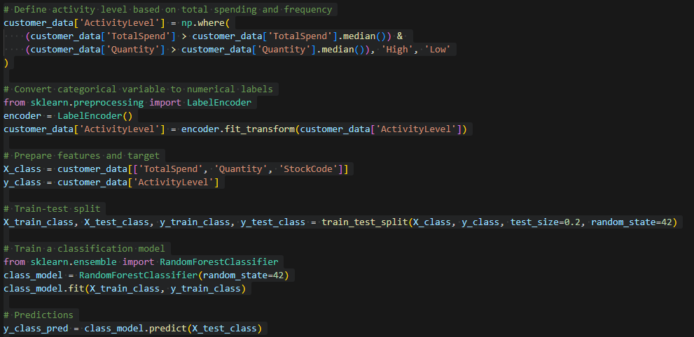
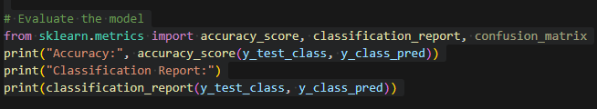
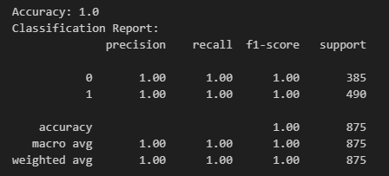

Slide 7
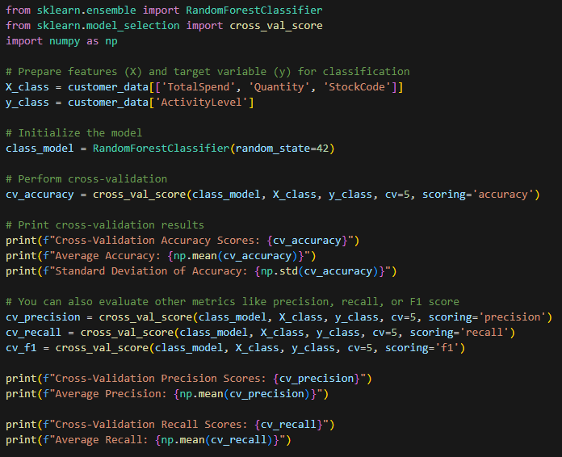
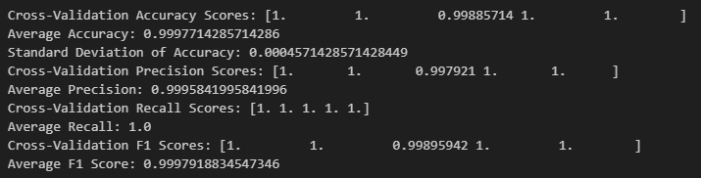


Slide 8
Exploratory Data Analysis (EDA)
Data Preprocessing:
Handle missing values.
Feature engineering (e.g., creating TotalSpend from Quantity and UnitPrice).
EDA Visualizations:
Distribution of Quantity and UnitPrice.
Boxplots to check for outliers.
Time-related patterns (transactions over time).

Slide 9
KMeans Clustering (Customer Segmentation)
Objective: Segment customers based on TotalSpend, Quantity, and StockCode.
Method: KMeans clustering with 4 clusters.
Visualizations: Pairplot of customer segments based on their purchasing behavior.
Insight: Identified distinct customer segments with varying purchase patterns.

Slide 10
Regression (Predicting Total Spend)
Objective: Predict the TotalSpend based on Quantity and UnitPrice.
Model: Linear Regression.
Evaluation Metrics:
Mean Absolute Error (MAE): 218.78
Mean Squared Error (MSE): 980,361.58
R² Score: 0.85 (Indicates good model fit).
Insight: The regression model performs well with an R² score of 0.85, meaning 85% of the variance in TotalSpend is explained by the model.

Slide 11
Classification (Predicting Activity Level)
Objective: Classify customers as 'High' or 'Low' activity level based on their TotalSpend and Quantity.
Method: Random Forest Classifier.
Activity Level Definition:
'High' if TotalSpend and Quantity are above the median.
'Low' otherwise.
Model Performance:
Accuracy: 1.00 (Perfect accuracy).
Precision: 1.00
Recall: 1.00
F1-Score: 1.00
Cross-Validation Scores:
Accuracy: 0.9997 (Average)
Precision: 0.9996 (Average)
Recall: 1.0 (Perfect recall)
F1-Score: 0.9998 (Average)

Slide 12
Cross-Validation Results
Cross-Validation Accuracy Scores:
[1.0, 1.0, 0.9989, 1.0, 1.0]
Average Accuracy: 0.9998
Standard Deviation: 0.00046 (Indicates high consistency).
Precision, Recall, and F1 Score: Very close to 1.0, showing the model is highly reliable.

Slide 13
Model Comparison
Regression Model (Total Spend):
R²: 0.85 (Good performance, predicting the total spend).
Predicts continuous values.
Classification Model (Activity Level):
Accuracy: 1.0 (Perfect classification).
Predicts categorical outcomes (High/Low activity).

Slide 14
Conclusion
Successfully analyzed and modeled customer behavior using clustering, regression, and classification techniques.
Models performed well with high accuracy and predictive power.
Business applications include customer segmentation, predicting spending behavior, and targeting high-value customers for marketing strategies.

Slide 15
Thank You

